Slide 1
Day3-Datawarehouse

Slide 2
What is a Data Warehouse?
A Data Warehouse (DW) is a centralized repository that stores historical and integrated data from multiple sources, designed specifically for reporting and analysis (not for daily operations).
It enables organizations to make data-driven business decisions through trends, patterns, and insights.
🧠 Think of it as the “single source of truth” for all organizational data.

Slide 3
🧩 Core Characteristics of a Data Warehouse
Characteristic | Meaning
Subject-Oriented | Organized around key business areas (sales, customers, products).
Integrated | Combines data from various sources into a consistent format.
Non-Volatile | Data is stable; once entered, it’s not changed or deleted frequently.
Time-Variant | Stores historical data for trend analysis (data has timestamps).

Slide 4
Denormalization
Denormalization is a database optimization technique that involves adding redundant data to tables to improve read performance and avoid costly JOIN operations.
It is a strategy applied after a database has been normalized, and it trades off data integrity and write performance for faster query execution, making it suitable for analytical and reporting systems.

Slide 5
Use cases
OLAP and data warehousing: Denormalization is commonly used in data warehouses and analytical systems where the priority is fast querying and report generation, rather than frequent data updates.

Slide 6
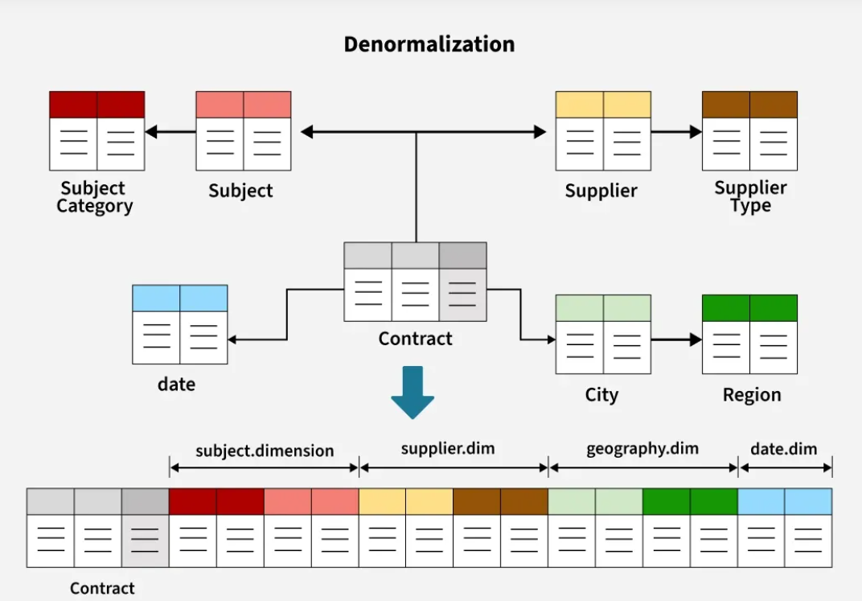

Slide 7
Dimensional modelling
Dimensional modeling uses a conceptual approach to design data warehouses for analytics, distinguishing it from the more detailed logical and physical models.
The conceptual phase defines the high-level business requirements and entities, while the logical model translates this into a detailed schema with attributes, primary keys, and foreign keys, which then serves as a blueprint for the physical implementation.
Dimensional modeling uses this overall framework but focuses on a star schema or snowflake schema design for the logical and physical levels to optimize for reporting.

Slide 8
Conceptual phase(High-Level)
What it is: A high-level representation of data entities and their relationships based on business requirements.
Key activities:
Identify key business processes.
Define entities, attributes, and relationships from a business perspective.
Establish business rules, such as "every sale must have at least one salesperson".
Purpose: To create a shared understanding of the data before implementation details are considered.

Slide 9
Logical phase (using dimensional modeling)
What it is: A detailed, implementation-agnostic schema that details how the data will be organized.
Key activities:
Translate conceptual entities into fact tables and dimension tables.
Define all attributes, data types, primary keys, and foreign keys for each table.
Choose a specific dimensional schema, such as star schema (denormalized dimensions) or snowflake schema (normalized dimensions).
Purpose: To provide a detailed blueprint for the physical database, optimized for analytical queries.

Slide 10
Physical phase(implementation phase)
What it is: The actual implementation of the logical model in a specific database management system (DBMS).
Key activities:
Specify the physical storage details, indexes, and partitions based on the chosen DBMS.
Purpose: To create the physical database structure based on the logical design.

Slide 11
Types of DWH tables
Dimension
Fact
Fact less Fact

Slide 12
Dimension Table
It is a DESCRIPTIVE attribute which talks about the describable information of any table/entity.
Example : Product Name/Category/type , customer location etc

Slide 13
Fact Table
It is all about measurable information wrt any Dimension table/entity.
Example : Sales Fact table
Sales Qty, Total Units sold are measurable attribs.
Fact table holds two sets of Information:
1.Dimension keys
2.Measurable fields information

Slide 14
Fact less Fact table
A fact less fact table is a data warehouse table that records events or conditions without any numeric facts, containing only foreign keys to related dimensions.
It is used to track processes, model many-to-many relationships, and enable "negative analysis" where you look for what didn't happen.
Examples:
Invoice Number,Tracking student attendance or product promotions that did not sell.

Slide 15
🧠 Data Warehouse vs Database
Feature | Database (OLTP) | Data Warehouse (OLAP)
Purpose | Daily operations | Analytics & reporting
Data Type | Current, real-time | Historical, summarized
Users | Clerical users | Analysts, managers
Operations | Insert, Update, Delete | Read, Aggregate, Analyze
Design | Normalized (3NF) | Denormalized (Star/Snowflake schema)

Slide 16
🗃️ Common Data Warehouse Schemas
Schema Type | Description | Example
Star Schema | Central fact table linked to multiple dimension tables. | Sales fact linked to Product, Time, Customer.
Snowflake Schema | Dimensions are further normalized into sub-dimensions. | Product → Category → Brand.
Galaxy (Fact Constellation) | Multiple fact tables share dimension tables. | Sales & Inventory facts share Product dimension.

Slide 17
DWH vs Data Lake
Feature | Data Warehouse | Data Lake
Data Type | Structured | All (Structured, Semi, Unstructured)
Processing | ETL (before loading) | ELT (after loading)
Schema | Schema-on-Write | Schema-on-Read
Cost | High | Low
Users | Business Analysts | Data Scientists
Purpose | BI, Reporting | AI, ML, Big Data
Tools | Snowflake, Redshift, BigQuery | Hadoop, AWS S3, Databricks

Slide 18
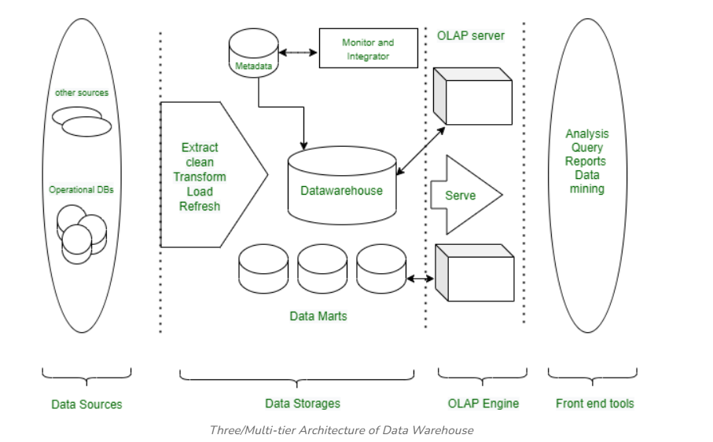
Data warehousing architecture

Slide 19
⚙️ Data Warehouse Architecture
1. Data Sources
Operational databases (OLTP)
Flat files, logs, ERP, CRM systems
2. Data Staging (ETL Layer)
Extract: Data is pulled from sources.
Transform: Cleaned and formatted.
Load: Loaded into the warehouse.
Tools: Informatica, Talend, AWS Glue, SSIS.
3. Data Storage (Warehouse Layer)
Central repository storing structured data.
Optimized for queries and analytics.
Databases: Snowflake, Amazon Redshift, Google BigQuery, Teradata.
4. Data Presentation Layer
Data Marts, OLAP cubes, BI tools (Power BI, Tableau, Looker).
Used for analytics and visualization.

Slide 20
Bottom Tier (Data Sources and Data Storage)
Middle Tier (OLAP Engine)
Top Tier (Front-End Tools)

Slide 21
Bottom Tier
Bottom Tier is the foundation of the data warehouse, responsible for collecting, processing, and storing data from multiple sources. It plays a critical role in preparing data for analysis.
Key Components:
Data Sources: Includes operational databases (OLTP systems), flat files, spreadsheets, external APIs, CRM/ERP systems, and web logs. These are the raw inputs feeding into the data warehouse.
Data Storage: Processed data is stored in a Relational Database Management System (RDBMS) or a multidimensional database designed to support structured querying and analysis.

Slide 22
Common Challenges in Bottom Tier
Integrating data from diverse sources presents several challenges such as:
Data Quality: Inconsistent data can lead to errors and unreliable analytics.
Data Compatibility: Different data formats and structures can complicate integration.
Scalability: Handling increasing volumes of data efficiently.

Slide 23
Solutions
Implement Robust ETL Tools: Utilize powerful ETL tools like Informatica, Microsoft SSIS, or Confluent to streamline the data integration process.
Standardize Data Formats: Standardizing data at the point of entry minimizes compatibility issues.
Continuous Data Quality Management: Regularly check and clean data to maintain high quality.
Scalability Planning: Design data storage solutions that can expand as data volume grows, ensuring that the architecture can handle future increases in data without performance degradation.

Slide 24
Middle Tier
The Middle Tier hosts the OLAP server, which processes complex analytical queries. It acts as a bridge between the data storage layer (bottom tier) and the user interface (top tier), ensuring data is quickly retrieved, aggregated, and ready for reporting and analysis.
OLAP is a powerful technology for complex calculations, trend analysis, and data modeling. It is designed for high-speed analytical processing. OLAP server models come in three different categories, including:
ROLAP (Relational OLAP): This model uses a relational database to store and manage warehouse data. It is ideal for handling large data volumes as it operates directly on relational databases.
MOLAP (Multidimensional OLAP): This model stores data in a multidimensional cube. The storage and retrieval processes are highly efficient, making MOLAP suitable for complex analytical queries that require aggregation.
HOLAP (Hybrid OLAP): It is combination of relational and multidimensional online analytical processing paradigms. HOLAP is the ideal option for a seamless functional flow across the database systems when the repository houses both the relational database management system and the multidimensional database management system.

Slide 25
Common Challenges in Middle Tier
Data Latency: Delays in data availability can impact decision-making.
Query Performance: Managing large volumes of data can slow down query performance.
Data Integration: Combining data from different sources with varying formats can be challenging.

Slide 26
Solutions
Real-Time & Incremental Loading: Update data frequently using real-time and incremental loading to reduce latency and support faster decision-making.
Query Optimization: Improve performance with indexing, partitioning, and optimized SQL for faster data retrieval.
Standardization & Integration Tools: Standardize data formats and use tools like Talend or Informatica for seamless integration and improved data quality.

Slide 27
Top Tier
The Top Tier in the Three-Tier Data Warehouse Architecture comprises the front-end client layer, which is essential for interacting with the data stored and processed in the lower tiers. This layer includes a variety of business intelligence (BI) tools and techniques designed to facilitate easy access and manipulation of data for reporting, analysis, and decision-making.
BI tools are critical components of the Top Tier, providing robust platforms through which users can query, report, and analyze data. Popular BI tools include:
IBM Cognos: Offers comprehensive reporting capabilities.
Microsoft BI Platform: Integrates well with existing Microsoft products, providing a familiar interface for users.
SAP BW: Specializes in managing large datasets and integrating with other SAP products.
Crystal Reports: Known for its powerful reporting features.
SAS Business Intelligence: Provides advanced analytics.
Pentaho: A versatile tool for data integration and visualization.

Slide 28
Operational Data Store(ODS)

Slide 29
An Operational Data Store (ODS) is a type of database that collects and combines data from various sources.
It provides a unified view of this data and offers real-time or near-real-time updates. Unlike data warehouses that focus on storing historical data, an ODS is designed to handle current operational data and supports immediate decision-making by delivering up-to-date information.

Slide 30
An Operational Data Store (ODS) is a centralized database that integrates real-time data from various sources to support operational reporting and decision-making.
Unlike data warehouses that store historical data, an ODS focuses on providing current data for immediate use.
It acts as a bridge between transactional systems and data warehouses, ensuring data consistency and quick access to up-to-date information.
This allows organizations to make timely decisions based on the latest data available

Slide 31
Key features of an ODS :
Real-time Data Integration: Data is collected and stored with the help of EDWs, and data is ready for usage immediately after its creation in the source systems.
Data Consolidation: The process where information from one source is combined with information from other sources to give a single output.
Low Latency: It is used and intended for easy reach of data and minimum time for accessing information.
Data Cleansing: Aids in data cleansing and data preparation to make it easier to work with for transformation and analysis.

Slide 32
Feature | Operational Data Store (ODS) | Data Warehouse (DW)
Primary Purpose | Support daily operations and provide current data | Support analytical processing and decision-making
Data Freshness | Near real-time or real-time | Historical, with periodic updates
Data Storage Duration | Short-term (days to weeks) | Long-term (months to years)
Data Integration | Data is integrated and consistent from various sources | Data is integrated, cleaned, and transformed
Data Usage | Operational reporting, quick queries | Complex queries, analytics, trend analysis
Data Structure | Typically normalized | Often de-normalized (star/snowflake schema)
Query Performance | Optimized for high volume of simple queries | Optimized for complex, analytical
User Access | Operational staff, line managers | Data analysts, business intelligence (BI) users
Update Frequency | Frequently updated (real-time or near real-time) | Less frequent updates (daily, weekly, monthly)
Data Scope | Current operational data | Comprehensive historical data
Granularity | More granular, focusing on individual transactions | Aggregated data, focusing on summaries and trends
Scalability | May require quick scaling due to real-time nature | Typically designed for large-scale, stable environments
Examples | Transactional data, current customer orders | Historical sales data, customer purchase history

Slide 33
What is Data Mart?
A data mart is a specialized subset of a data warehouse focused on a specific functional area or department within an organization.
It provides a simplified and targeted view of data, addressing specific reporting and analytical needs.
Data marts are smaller in scale and scope, typically holding relevant data for a specific group of users, such as sales, marketing, or finance.
They are organized around specific subjects, such as sales, customer data, or product information, and are structured, transformed, and optimized for efficient querying and analysis within the domain.

Slide 34
Types of Data Mart
Independent Data Mart
Dependent Data Mart
Hybrid Data Mart

Slide 35
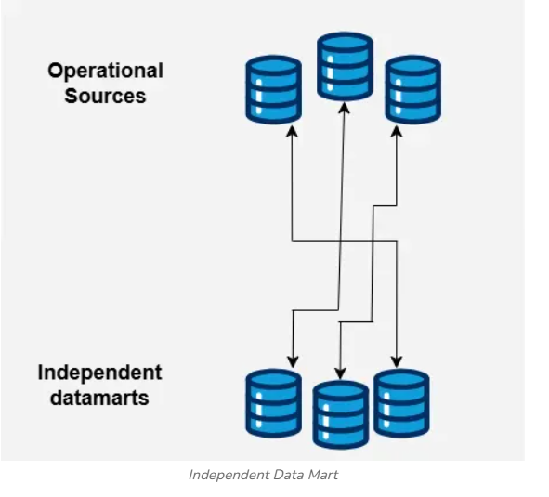
1. Independent Data Mart
An independent data mart is created and maintained separately from the data warehouse. It is created to satisfy the particular needs of a specific business unit or department.
Independent data marts are typically smaller in size and more rapidly and readily set up.
They offer flexibility and agility since they are not constrained by the challenges of the centralized data warehouse. Nevertheless, data redundancy and inconsistency may result if it is replicated over several different data marts.

Slide 36
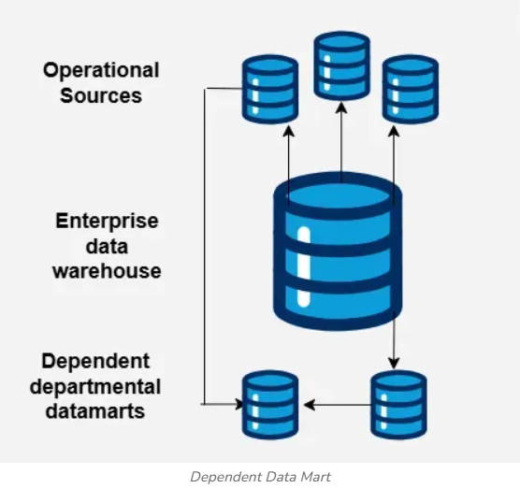
2. Dependent Data Mart
A dependent data mart is generated right out of a data warehouse.
It takes some of the data from the data warehouse and arranges it to meet the needs of a specific industry. Dependent data marts, which profit from the data integration, data quality, and consistency provided by the data warehouse, allow for the centralization and preservation of all data in a single source of truth.
They are often developed to serve particular reporting and analytical needs, and they are frequently updated from the data warehouse.
Dependent data marts offer data consistency and prevent data duplication because they rely on the data warehouse as their main source of data.

Slide 37
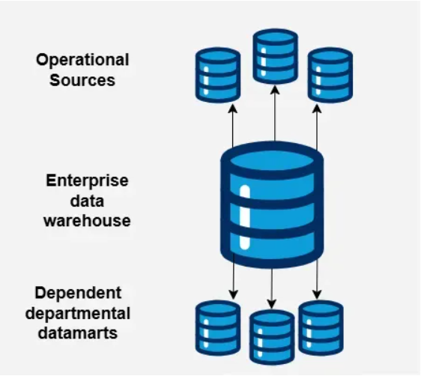
3. Hybrid Data Mart
Both independent and dependent data mart components can be found in a hybrid data mart.
As well as combining additional data sources particular to a given business unit or department, it makes use of the centralized data warehouse for the integration and consistency of the core data.
By offering flexibility and agility for department-specific needs while keeping the integrity and consistency of shared data from the data warehouse, hybrid data marts offer the benefits of both strategies.
This strategy creates a balance between localized data management and centralized data management.

